Slide 1
SWTest Asia Golf Tournament at the Royal Kuan-Hsi Golf Club
Wednesday, October 16th

Slide 2
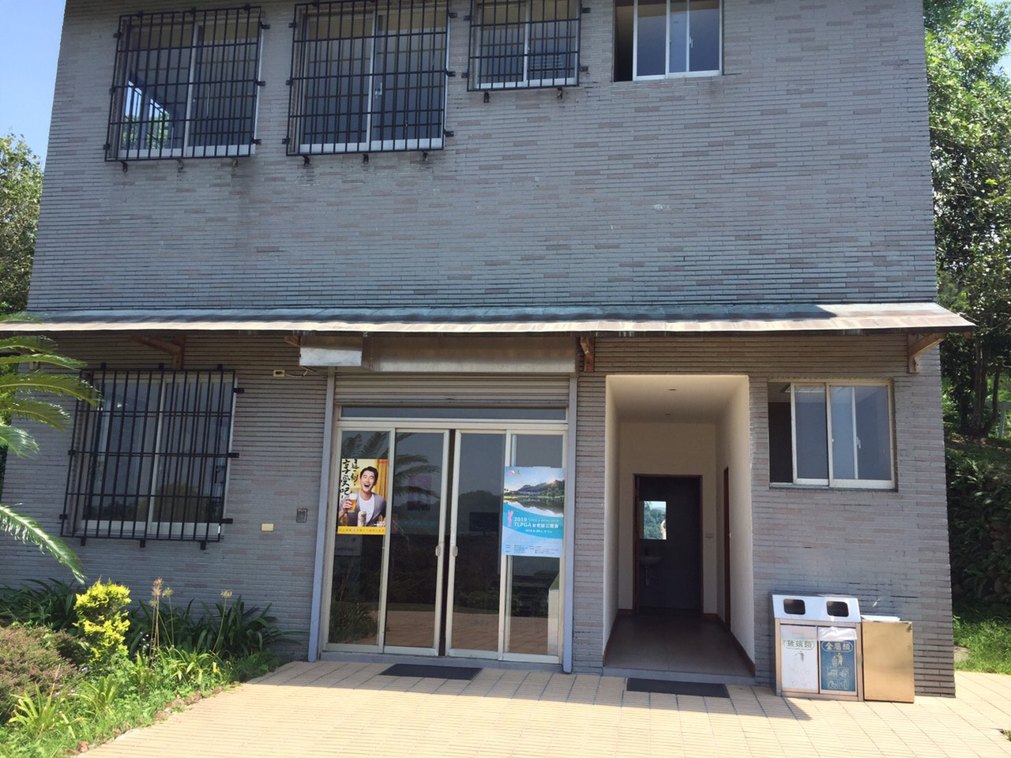
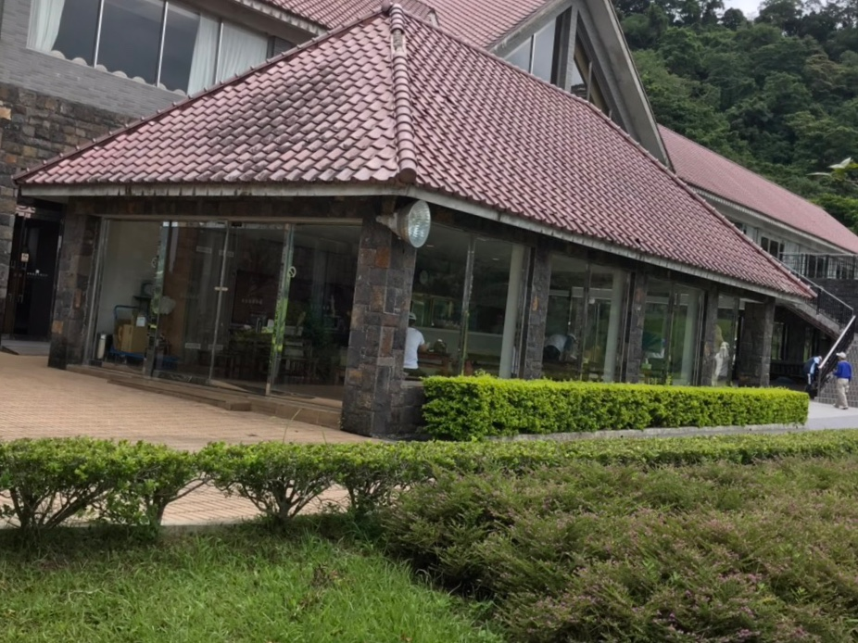
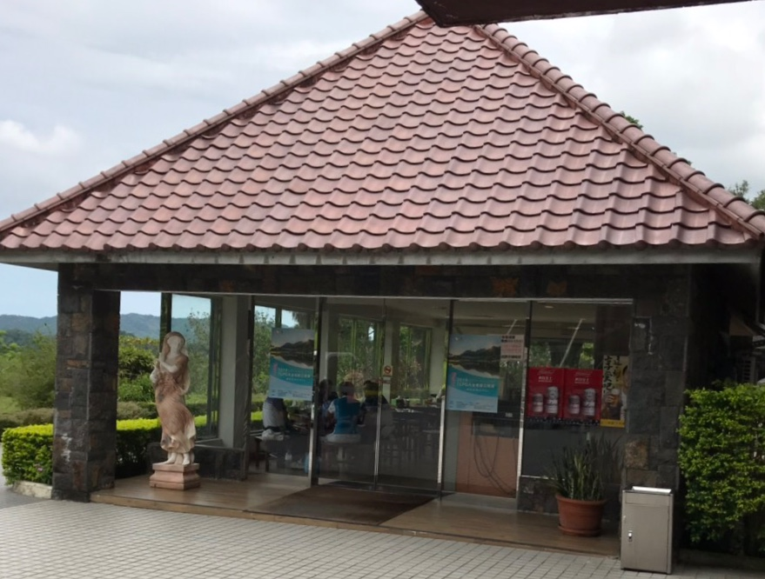
Sponsor Shops
Sponsor Shop at
Hole 15 tee
Hole 4 green
Sponsor Shop at
Hole 10 tee
Hole 18 green

Slide 3
Short course
For “Closest to the Pin” Sponsors

Slide 4
Long course
For “Longest Drive” Sponsors

Slide 5
Pro course
For “Beat the Pro” Contest
Compilation
(DR/Wood/Long Iron)
Golf Club Rental
6 sets for right-handed players
1 set for left-handed players

